Slide 1
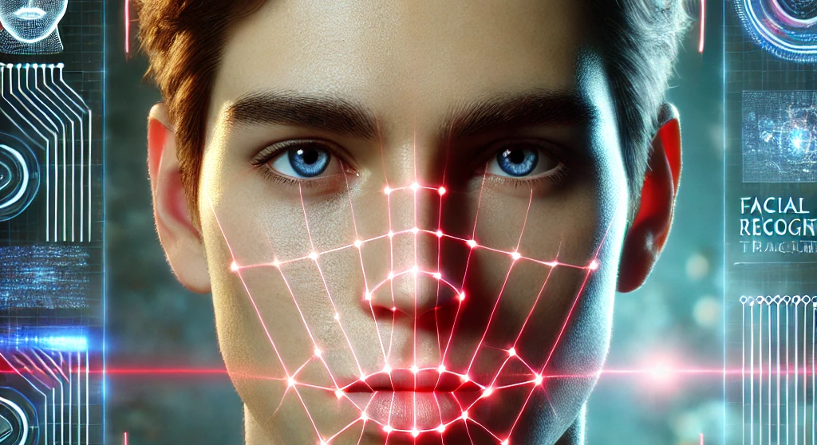
Viso Speak
Students : Majd Salameh, Morad Asakli
Supervisor : Ilya Zeldner

Slide 2
The Idea Behind VisoSpeak
VisoSpeak is a deep learning tool that helps with lip reading using only visuals.
Regular speech recognition doesn't work well in noisy places or when there's no sound.
many models are tied to specific languages.
VisoSpeak fixes these issues by focusing only on lip movements, making it more private and accessible.
Notes:
VisoSpeak is a deep learning tool that helps with lip reading using only visuals. Regular speech recognition doesn't work well in noisy places or when there's no sound. Also, many models are tied to specific languages. VisoSpeak fixes these issues by focusing only on lip movements, making it more private and accessible. Our project is built upon improving an existing lip-reading model from 2020, which had strong potential but needed enhancements. We refined its approach by making it more accurate and adaptable to different speaking styles

Slide 3
Exploring Existing Projects
LipNet (2016) - Works end-to-end but struggles with accuracy.
Lip Reading Sentences in the Wild (2017) - Uses both audio and video.
Lip Reading Sentences Using Deep Learning (2020) - Focuses on visual cues but uses fixed timestamps.
Notes:
We explored several existing projects in lip reading and identified three key models that have shaped this field.
LipNet (2016) – First end-to-end model, but low accuracy.
Lip Reading Sentences in the Wild (2017) – Uses audio and video, not purely visual.
Lip Reading Sentences Using Deep Learning (2020) – Fully visual but relies on fixed timestamps.
Each of these projects contributed valuable advancements, but they also had limitations.
We focused on the third model because it uses viseme classification, which makes it more flexible and adaptable for visual-only speech recognition

Slide 4
The Project We Chose
We chose the 2020 lip-reading system.
It uses viseme classification for better accuracy.
Its weakness : relies on Static Timestamps
Fixing this improves functionality and accuracy.
Notes:
The project we chose to improve is the 2020 lip-reading system. We selected this model because it utilizes viseme classification, which makes it more flexible and adaptable for recognizing speech through visual cues. However, we identified a key weakness: it relies on static timestamps to segment speech, which limits its accuracy and adaptability.
By replacing static timestamps with dynamic timestamps, we can make the system more responsive to different speaking speeds and improve overall accuracy. This enhancement makes the model more effective in real-world scenarios where speech patterns vary

Slide 5

Limitations of the Previous Approach
Uses fixed timestamps for detecting word boundaries.
Relies on a predefined time structure.
Struggles with different speaking speeds.
Weakness: Pre-assign the beginning and end of the word
Notes:
The old algorithm used fixed timestamps to detect word boundaries, meaning it followed a rigid timing structure that did not adjust based on the speaker’s natural pace. This caused errors, especially when people spoke too fast or too slow.
Because the algorithm did not adapt to different speaking speeds, it often incorrectly segmented words, reducing its accuracy. This limitation made it less reliable in real-world scenarios

Slide 6

How We Improved the Approach
Replaced fixed timestamps with dynamic timestamps.
Added 8 variables to calculate average time between words and letters.
Achieves better accuracy in detecting word boundaries.
Adapts to different speaking speeds
→ Our main goal is to identify the Space as a word
Notes:
One of the biggest weaknesses of the previous approach was its reliance on fixed timestamps, which did not adjust to different speaking speeds. To solve this, we replaced them with dynamic timestamps, allowing the system to adapt in real-time to the speaker’s pace.
To improve word boundary detection, we introduced 8 new variables that help calculate the average time between words and letters for each user. This personalized approach ensures better segmentation and higher accuracy, making the system more effective in real-world scenarios.

Slide 7
Full Process Flow Overview Video Upload
Video Upload
Face Detection
Lip Detection
Preprocessing
Feature
Extraction
O(1)
Output
Sentence
Reconstruction
Viseme Classification
Simple I/O operation
Notes:
we see the full process flow of our system. The flow begins with the video upload and progresses through each stage until we reach the final output. Let’s now break down each step and explain how the algorithms work in detail.
The first step in the process is simply uploading the video. This is the starting point, where the user provides the video file in MP4 format. There's no complex algorithm involved here; it's just an I/O operation to upload the file. The time complexity here is O(1), as it’s independent of the video size.

Slide 8
Full Process Flow Overview Face Detection
Video Upload
Face Detection
Lip Detection
Preprocessing
Feature
Extraction
O(1)
O(n*m)
Output
Sentence
Reconstruction
Viseme Classification
Algorithm: SSD (Single Shot MultiBox Detector)
n- number of frames
m- number of pixel in each frame.
Notes:
The second step is face detection. We use the Single Shot MultiBox Detector (SSD) algorithm, a deep learning-based model that detects faces within the video frames. SSD is efficient and fast, and it works by sliding over the image at different scales. The time complexity for face detection is O(n * m), where n is the number of frames and m is the number of pixels in each frame.

Slide 9
Full Process Flow Overview Lip Detection
Video Upload
Face Detection
Lip Detection
Preprocessing
Feature
Extraction
O(1)
O(n*m)
O(n*m*d)
Output
Sentence
Reconstruction
Viseme Classification
iBug 68-landmark model
n- number of frames
m- number of pixel in each frame
d-number of landmarks detected
Notes:
After detecting the face, the next step is lip detection. We focus on identifying the lip region in the video. This is done using a CNN (Convolutional Neural Network), a deep learning technique that helps us identify key facial landmarks. The time complexity for lip detection is O(n * m * d), where d is the number of landmarks detected, and this step ensures that we focus only on the lips for further analysis."

Slide 10
Full Process Flow Overview Preprocessing Frames
Video Upload
Face Detection
Lip Detection
Preprocessing
Feature
Extraction
O(1)
O(n*m)
O(n*m*d)
O(n*m)
Output
Sentence
Reconstruction
Viseme Classification
Convert, Normalize using Z-score normalization& Crop
n- number of frames
m- number of pixel in each frame.
Notes:
Now that we’ve detected the lips, we preprocess the frames. This involves converting the video frames to grayscale, normalizing pixel values, and cropping to focus on the lip region. This preprocessing step ensures that the model can focus on the relevant parts of the video, reducing noise and improving accuracy. The time complexity is O(n * m), where n is the number of frames and m is the number of pixels per frame.

Slide 11
Full Process Flow Overview Feature Extraction
O(n*m*f*k)+
O(n*m*d)
Video Upload
Face Detection
Lip Detection
Preprocessing
Feature
Extraction
O(1)
O(n*m)
O(n*m*d)
O(n*m)
Output
Sentence
Reconstruction
Viseme Classification
Algorithm: 3D-CNN + 2D-ResNet
n- number of frames
m- number of pixel in each frame
f-filter size
k-number of filters
d- feature dimension
Notes:
The next step is feature extraction. We use 3D-CNN (3D Convolutional Neural Networks) to capture spatial and temporal features across consecutive frames. This allows the system to understand the movement and context over time. Additionally, we use 2D-ResNet, a deep network architecture, for dimensionality reduction. This reduces the complexity of the features while retaining important visual information. The time complexity for 3D-CNN is O(n * m * f * k), where f is the filter size and k is the number of filters. For ResNet, it's O(n * m * d), where d is the feature dimension.
We dynamically adjust the timing variables such as Space Between Letters (SBL) and Space Between Words (SBW) based on the speaking speed. If the speaker talks quickly, we compress the space between letters and words; if the speaker talks slowly, we expand those spaces. This allows the system to be more accurate when processing frames at different paces

Slide 12
Full Process Flow Overview Viseme Classification
O(n*m*f*k)+
O(n*m*d)
Video Upload
Face Detection
Lip Detection
Preprocessing
Feature
Extraction
O(1)
O(n*m)
O(n*m*d)
O(n*m)
Output
Sentence
Reconstruction
Viseme Classification
O(n*d*T)
Algorithm: Transformer-based encoder-decoder.
n- number of frames
d- feature dimension
T-number of layers in the model
Notes:
Once the features are extracted, we move to viseme classification. Here, we use a Transformer model to process the features and classify them into visemes. Visemes are visual representations of phonemes, and the Transformer helps us understand the relationship between them over time. The time complexity of the Transformer model is O(n * d * T), where n is the number of frames, d is the feature dimension, and T is the number of layers in the model. The system classifies visemes using a Transformer model. The key improvement here is dynamic timing. For instance, the system dynamically adjusts the Space Between Letters (SBL) and Space Between Words (SBW) based on speaking speed. This allows the model to recognize faster or slower speech more accurately.

Slide 13
Full Process Flow Overview Sentence Reconstruction
O(n*m*f*k)+
O(n*m*d)
Video Upload
Face Detection
Lip Detection
Preprocessing
Feature
Extraction
O(1)
O(n*m)
O(n*m*d)
O(n*m)
Output
Sentence
Reconstruction
Viseme Classification
O(v*p)
O(n*d*T)
Algorithm: Beam Search with Perplexity Analysis.
V - vocabulary size
p - number of possible word combinations
Notes:
Now we come to sentence reconstruction. We use Beam Search, a search algorithm, to find the most likely sequence of words based on the visemes. Beam Search evaluates multiple possible sequences and selects the one with the highest probability, improving the overall accuracy of word and sentence detection. The time complexity for Beam Search is O(v * p), where v is the vocabulary size and p is the number of possible word combinations.

Slide 14
Full Process Flow Overview Preprocessing Frames
O(n*m*f*k)+
O(n*m*d)
Video Upload
Face Detection
Lip Detection
Preprocessing
Feature
Extraction
O(1)
O(n*m)
O(n*m*d)
O(n*m)
Output
Sentence
Reconstruction
Viseme Classification
O(1)
O(v*p)
O(n*d*T)
Desired Output
Notes:
Summary of time complexity

Slide 15
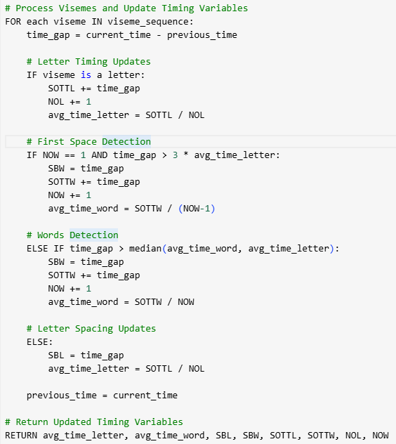
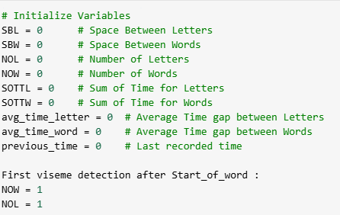
Pseudo Code
The 8 Key Variables

Slide 16
Simulation
Viseme | Timestamp (ms) | Time Gap (ms) | Action | Updated Variables
M | 0 | - | Start | No updates
OW | 120 | 120 | Letter | SOTTL = 120, NOL = 1, avg_time_letter = 120
R | 230 | 110 | Letter | SOTTL = 230, NOL = 2, avg_time_letter = 115
AE | 340 | 110 | Letter | SOTTL = 340, NOL = 3, avg_time_letter = 113
D | 470 | 130 | Letter | SOTTL = 470, NOL = 4, avg_time_letter = 118
(space) | 900 | 430 | First Word Detected | SBW = 430, SOTTW = 430, NOW = 1, avg_time_word = 430
AE | 1010 | 110 | Letter | SOTTL = 580, NOL = 5, avg_time_letter = 116
N | 1120 | 110 | Letter | SOTTL = 690, NOL = 6, avg_time_letter = 115
D | 1240 | 120 | Letter | SOTTL = 810, NOL = 7, avg_time_letter = 116
(space) | 1600 | 360 | New Word Detected | SBW = 360, SOTTW = 790, NOW = 2, avg_time_word = 395
M | 1720 | 120 | Letter | SOTTL = 930, NOL = 8, avg_time_letter = 116
AE | 1840 | 120 | Letter | SOTTL = 1050, NOL = 9, avg_time_letter = 116
JH | 1960 | 120 | Letter | SOTTL = 1170, NOL = 10, avg_time_letter = 117
D | 2100 | 140 | Letter | SOTTL = 1310, NOL = 11, avg_time_letter = 119
morad → M OW R AE D
and → AE N D
majd → M AE JH D
Input :
Morad and Majd
<sow>, <eow>, <sos>, <eos>, [space]
SBL - Space Between Letters
SBW - Space Between Words
NOL - Number of Letters
NOW - Number of Words
SOTTL - Sum of Time for Letters
SOTTW - Sum of Time for Words
avg_time_letter - Average Letter Time avg_time_word - Average Word
Output:
["SOS","SOW" ," M ", " OW ", " R ", " AE ", " D “,"EOW", "SPACE","SOW", " AE ", "N", " D ", "EOW«
, "SPACE","SOW ", " M ", "AE", " JH ", " D ", "EOW","EOS"]

Slide 17
Summary
More accurate word boundary detection
Detect Space as a word
Adapts to different speaking speeds
Enhances real-world performance
Notes:
Our improvements enhance word boundary detection and sentence accuracy, making the system adapt to different speaking speeds. These changes improve real-world performance and reliability.

Slide 18
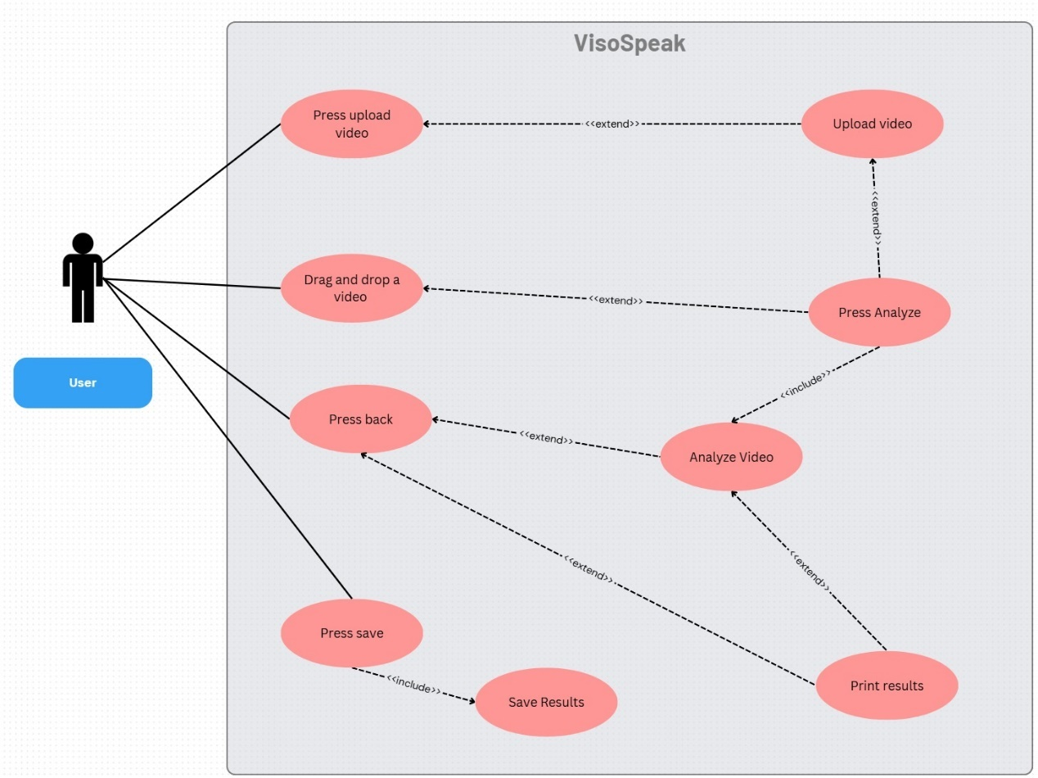
Use Case Diagram
Notes:
This Use Case Diagram represents the main interactions a user has with the VisoSpeak system.
The user can upload a video either by pressing the upload button or by dragging and dropping a file into the system.
Once the video is uploaded, the user can press the analyze button, which triggers the analyze video process.
After analysis, the system allows the user to print the results or save them for future reference.
There is also a back button that lets users navigate the interface smoothly.

Slide 19
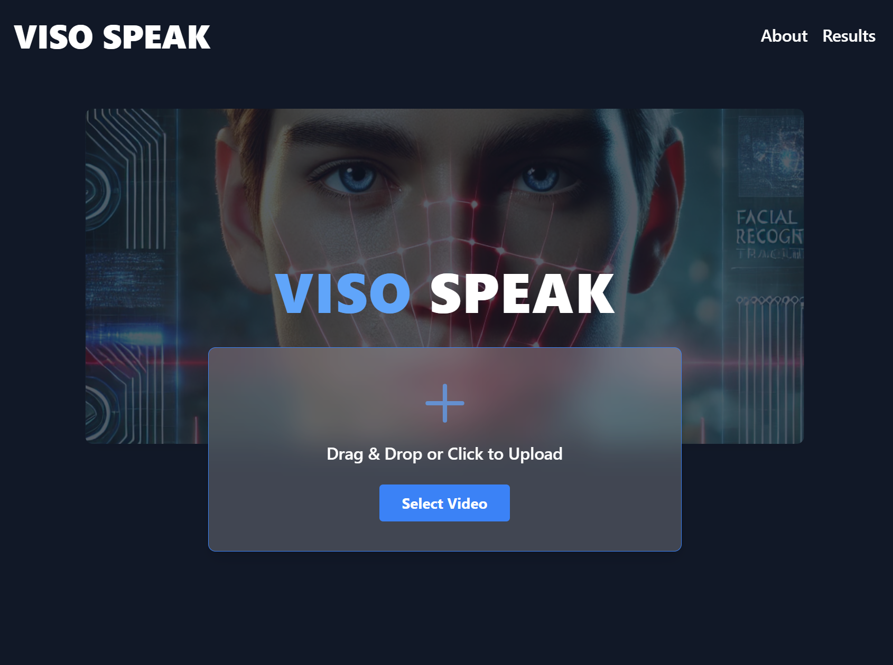
Home Screen

Slide 20
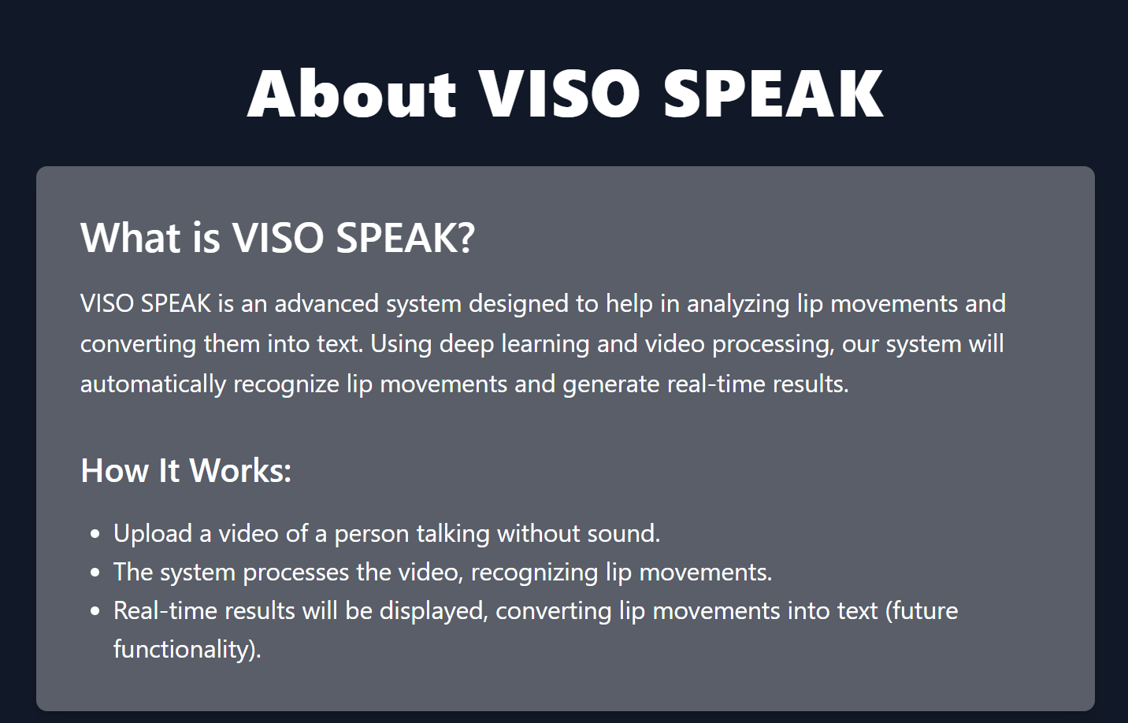
About Screen

Slide 21
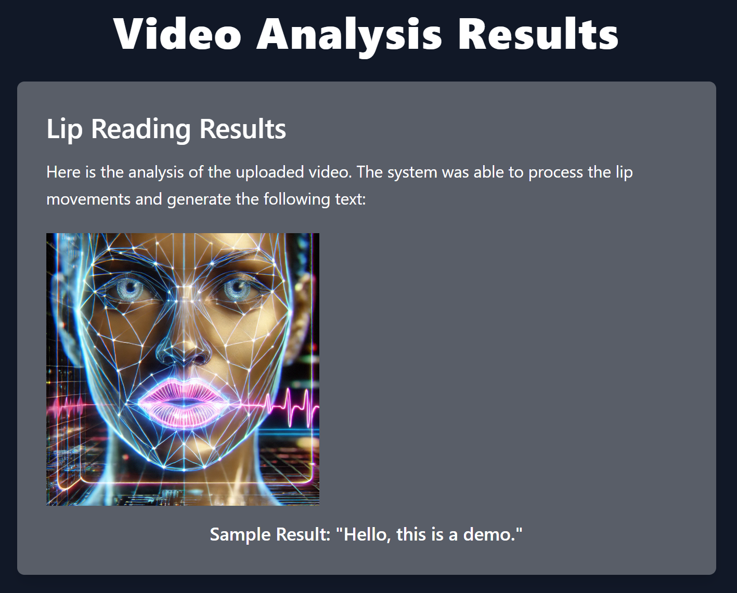
Result Screen

Slide 22
References
[1] | A. S. O. V. A. Z. Joon Son Chung, "Lip Reading Sentences in the Wild," in IEEE Conference on Computer Vision and Pattern Recognition, 2017.
[2] | D. C. K. G. P. X. Souheil Fenghour, "Lip Reading Sentences Using Deep Learning With Only Visual Cues," 2020.
[3] | B. S. S. W. N. d. F. Yannis Assael, "LipNet: Sentence-Level Lipreading," 2016.
[4] | X. Z. S. R. J. S. Kaiming He, "Deep Residual Learning for Image Recognition," in IEEE Conference on Computer Vision and Pattern Recognition (CVPR), 2015.
[5] | W. X. M. Y. K. Y. Shuiwang Ji, "3D Convolutional Neural Networks for Human Action Recognition," in 27th International Conference on Machine Learning, 2010.
[6] | D. Y. Soonkyu Lee, "Audio-to-Visual Conversion Using Hidden Markov Models," in PRICAI 2002, LNAI 2417, 2002.
[7] | C. L. L. R. C. H. W. R. Sofia Lemons, " Beam Search: Faster and Monotonic," in 32nd International Conference on Automated Planning and Scheduling (ICAPS), 2022.
[8] | T. V. R. C. Clara Meister, "Best-First Beam Search," in Transactions of the Association for Computational Linguistics, 2020.
[9] | K. N. T. S. I. S. Alec Radford, " Improving Language Understanding by Generative Pre-Training," in OpenAI.
[10] | D. A. D. E. C. S. S. R. C.-Y. F. A. C. B. Wei Liu, "SSD: Single Shot MultiBox Detector," in Lecture Notes in Computer Science, 2016.

Slide 23

Thank you for listening

